Slide 1
I211 – Information Infrastructure II
Lecture 12

Slide 2
What is XML?
eXtensible Markup Language
Designed to carry data, not formatting information!
By itself, XML doesn’t do anything: it’s a data structure, like a list!
Programs use it to store and translate data.

Slide 3
When do we use XML?
XML is good for situations with complicated data (objects!):
Student
Name, age, major, bursar balance, etc.
Stock quote
Symbol, last trade, daily change, high, low, etc.
Checking account
Account number, balance, amount withdrawn, etc.
What happens to our programs if the structure of the data changes?

Slide 4
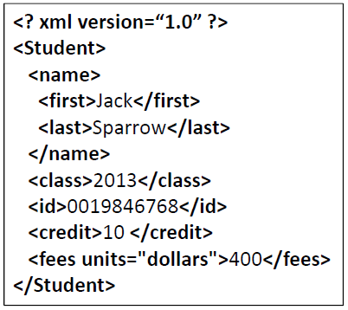
What does XML look like?
We can tell what this data is:
It’s dense, but it’s easier to parse with a program.
If the order changes or new data is added, we can still make sense of the old data

Slide 5
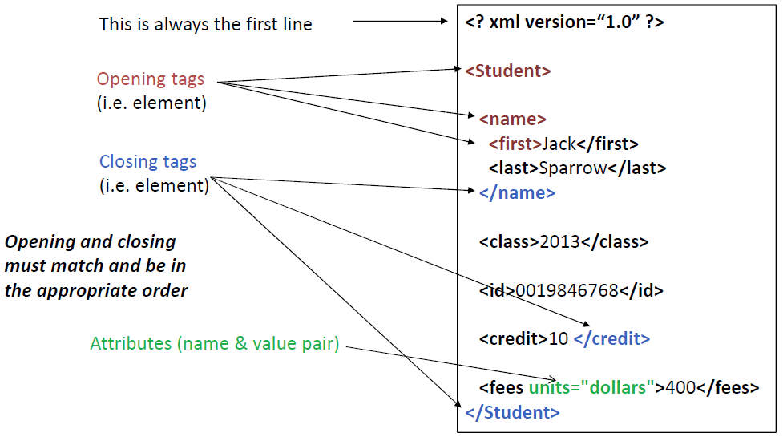
Structure of an XML Document

Slide 6
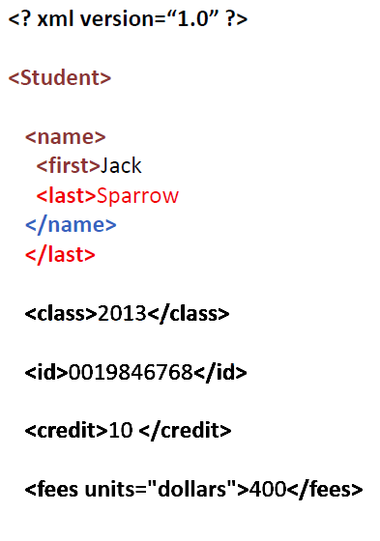
Incorrect Structure
No matching closing tag!
Nesting is incorrect!

Slide 7
Proper XML
Proper XML has two requirements:
Well-formed: Opening and closing tags match, nesting is correct
Valid: The right tags are used in the right places
A <name> tag should only appear inside a <Student> tag
Validity changes by document, and we’re not going to worry about it, but we do care about the document being well-formed!

Slide 8
Reading XML
Normally, we want to extract the data
We might do this in an iterative fashion:
Get a Student element
Read the first name
Read the last name
Read the class
Read the amount of student fees

Slide 9
Parsing XML
The process of extracting data from an XML document is called parsing.
We’ll be using a parser called ElementTree, which builds a tree structure for the tags.

Slide 10
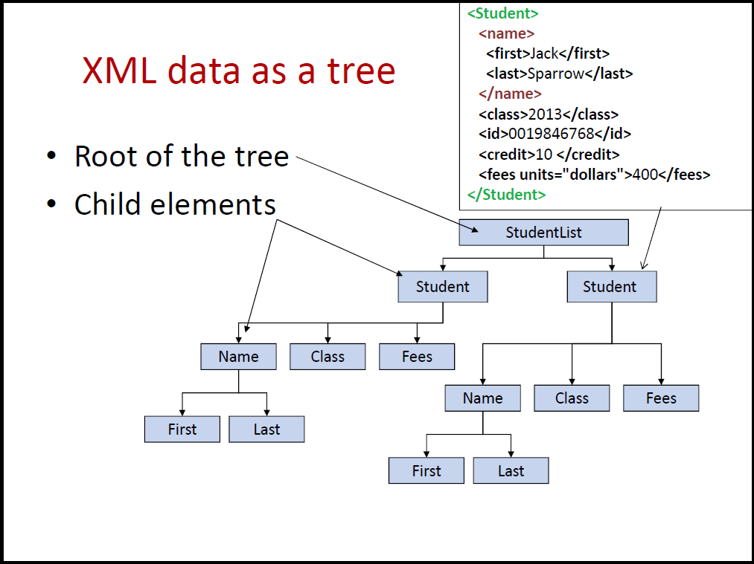
XML as a Tree

Slide 11
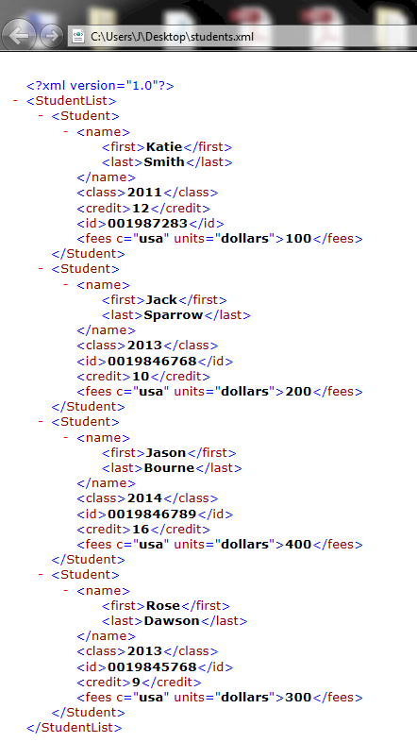
XML
Download students.xml from Oncourse and open it in a web browser.
By itself, the data does nothing, but we can open and close the nested tags by clicking on the – and +

Slide 12
XML and Python
Try this out:
import xml.etree.ElementTree as ET
root = ET.parse(source="students.xml")
print root
Root is the root of the tree. By default, it will just print out the memory location, like this:
<xml.etree.ElementTree.ElementTree object at 0x0000000002A0C9B0>

Slide 13
XML Parse Tree
Let’s get a better look at the XML tree:
import xml.etree.ElementTree as ET
root = ET.parse(source="students.xml")
elements = root.getiterator() #creates a list of elements!
for elem in elements: #prints out the details
print "Tag Name:", elem.tag
print "Tag Text:", elem.text
print "Tag Attributes:", elem.items()
print "Children:", list(elem)
print "-"*20

Slide 14
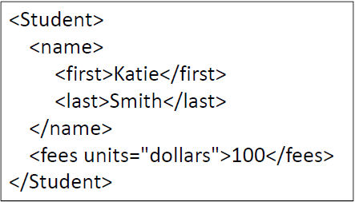
An XML Element
Each element corresponds to an XML element
Starts at the opening tag, ends at the closing tag
Four things:
Tag – the name of the element
Text – the content of the element (if any)
Attributes (if any)
Child elements (if any)

Slide 15
An XML Element
When we hit the fees element:
Content: Value:
elem.tag fees
elem.text 100
elem.items() (“units”, “dollars”)
list(elem) No children

Slide 16
XML Parse Tree
We can choose which tags to process:
import xml.etree.ElementTree as ET
root = ET.parse(source="students.xml")
elements = root.getiterator()
for elem in elements:
if elem.tag == "name": #should get 4 matches!
print "Tag Name:", elem.tag
print "Children:", list(elem)
print "-"*20

Slide 17
XML
Attributes provide useful information about data
Units of measurement
Currency type
Language
Each element object has a method called .items(), which returns a list of:
Attribute name, attribute value pairs (as tuples!)

Slide 18
XML
Examining attributes:
import xml.etree.ElementTree as ET
root = ET.parse(source="students.xml")
elements = root.getiterator()
for elem in elements:
if elem.tag == "fees":
attributes = list(elem.items())
print "Attributes:", attributes
print "-"*20

Slide 19
XML as a string
If we get an XML document asa string, we can parse it using the XML method!
import xml.etree.ElementTree as ET
root2 = ET.XML("<top attrib1='val1'><middle>Words!</middle></top>")
print root2
elements = root2.getiterator()
for elem in elements:
print "Tag Name:", elem.tag
print "Tag Text:", elem.text
print "Tag Attributes:", elem.items()
print "Children:", list(elem)
print "-"*20

Slide 20
XML
Some useful methods:
find(query) – this method returns the first sub-element whose tag matches query
findall(query) – returns a list of all sub-elements whose tag matches query
query should be an element name or path

Slide 21
XML
Try this:
import xml.etree.ElementTree as ET
root = ET.parse(source="students.xml")
names = root.findall("name")
for name in names:
print name.text
Why doesn’t it work?

Slide 22
XML
Remember the tree?
root.findall("name") is trying to find an element called name that’s directly related to the root!
But that’s not where the names are! We need to specify a path to the names.

Slide 23
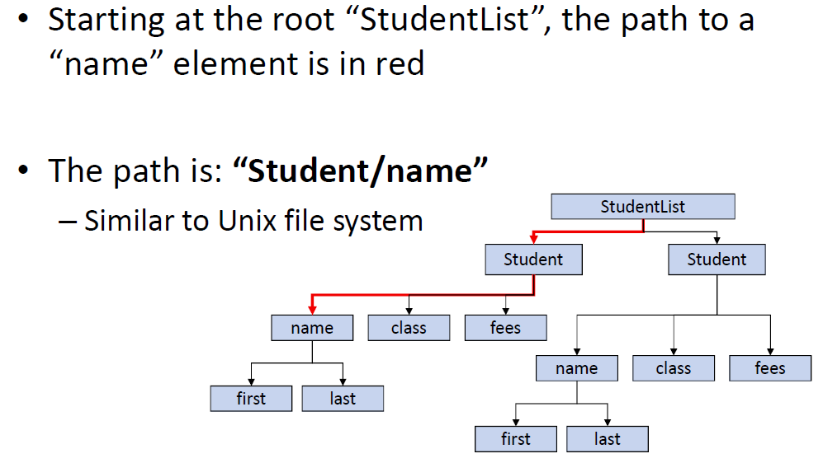
XML path

Slide 24
XML
So let’s get all the first names:
import xml.etree.ElementTree as ET
root = ET.parse(source="students.xml")
names = root.findall("Student/name/first")
for elem in names:
print elem.text

Slide 25
XML
find() is handy, but you lose the context of the data!
If that doesn’t matter, then use find()
Use findall() when you need to do something like add up all elements of type X.
If you need the context, use getiterator(), and walk through the elements manually.

Slide 26
Student Info 1 (Group Work)
Write a program to compute and display the following info from the students.xml file:
>>>
The students are:
Katie Smith
Jack Sparrow
Jason Bourne
Rose Dawson

Slide 27
Student Info 1 (Solution)
import xml.etree.ElementTree as ET
root = ET.parse(source="students.xml")
elements = root.getiterator()
print "The students are:"
for elem in elements:
if elem.tag == "Student":
name = elem.find("name/first").text + " "
name += elem.find("name/last").text
print name

Slide 28
Student Info 2 (Group Work)
Write a program to compute and display the following info from the students.xml file:
>>>
The total amount of student fees is: $ 1000

Slide 29
Student Info 2 (Solution)
import xml.etree.ElementTree as ET
root = ET.parse(source="students.xml")
elements = root.getiterator()
print "The total amount of student fees is: $",
print sum([int(elem.text) for elem in root.findall("Student/fees")])

Slide 30
Student Info 3 (Group Work)
Write a program to compute and display the following info from the students.xml file:
>>>
The unique tags are:
['StudentList', 'Student', 'name', 'first', 'last', 'class', 'credit', 'id', 'fees']

Slide 31
Student Info 3 (Solution)
import xml.etree.ElementTree as ET
root = ET.parse(source="students.xml")
tags = []
elements = root.getiterator()
for elem in elements:
if elem.tag not in tags:
tags.append(elem.tag)
print "The unique tags are:", tags, "\n"

Slide 32
Link Finder v3 (Group Work)
Use XML parsing to find the “/wiki/” links on a Wikipedia page:
>>>
The links on http://en.wikipedia.org/wiki/Pendang are:
/wiki/Districts_of_Malaysia
/wiki/Malaysia
/wiki/Malaysia
/wiki/States_and_federal_territories_of_Malaysia
/wiki/Kedah
/wiki/Kedah
/wiki/Malaysia
/wiki/Template:Kedah
/wiki/Template_talk:Kedah
/wiki/File:Flag_of_Kedah.svg
/wiki/Kedah
/wiki/Baling/wiki/Padang_Terap
…
/wiki/Help:Contents
/wiki/Wikipedia:About
/wiki/Wikipedia:Community_portal
/wiki/Wikipedia:About
/wiki/Wikipedia:General_disclaimer
HINTS:
Read the entire page as a string and convert it to XML using ET.XML()
.items() produces a list of tuples of attributes! You can then break that apart…
You want links that include “/wiki” but don’t include “.org”!

Slide 33
Link Finder v3 (Solution)
import urllib, xml.etree.ElementTree as ET
def xml_links(url):
web_page = urllib.urlopen(url)
lines = web_page.read()
web_page.close()
root = ET.XML(lines)
elements = root.getiterator()
print "The links on", url, "are:\n"
for elem in elements:
if elem.tag == "a":
if elem.items()[0][0] == "href":
if "/wiki/" in elem.items()[0][1] and ".org" not in elem.items()[0][1]:
print elem.items()[0][1]
xml_links("http://en.wikipedia.org/wiki/Pendang")

Slide 34
XML Links
A More In-depth Intro to XML:
http://www.extropia.com/tutorials/xml/toc.html
Python Documentation for Element Tree:
http://docs.python.org/library/xml.etree.elementtree.html

Slide 35
Questions?

